Slide 1


Analysis on Cancer Data in California
[HDMA] Spring 2018
GrAHPeRs Caner Mapping Project
02/28/2018
Chanwoo Jin

Slide 2
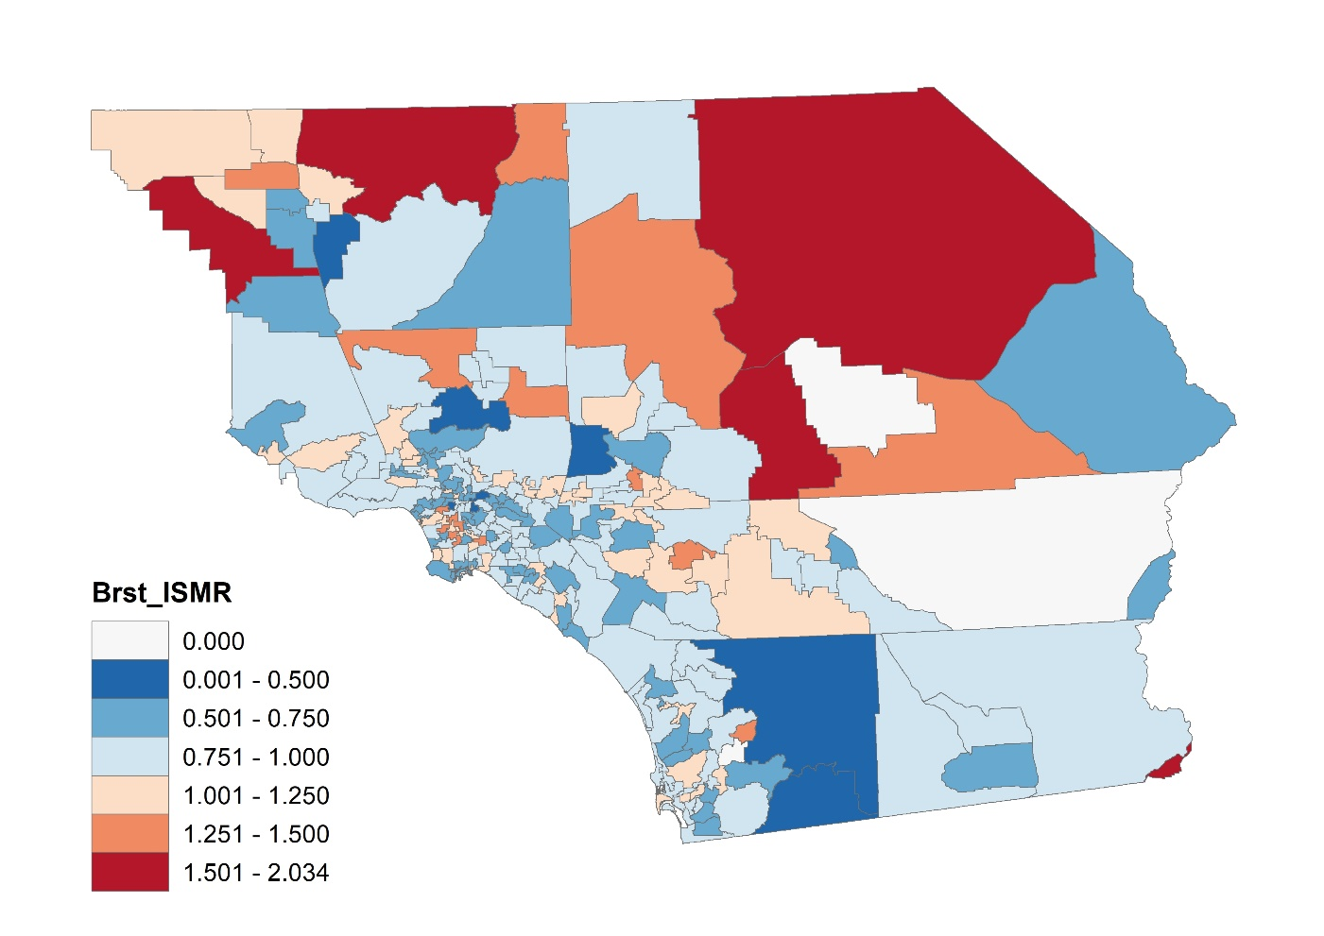
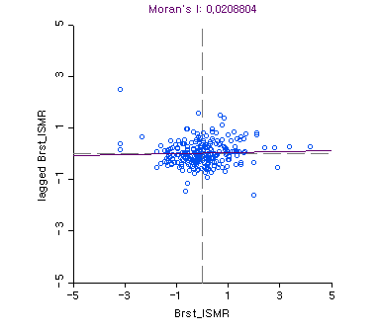
I. Spatial Distribution of Cancer
Breast Cancer: ISMR

Slide 3
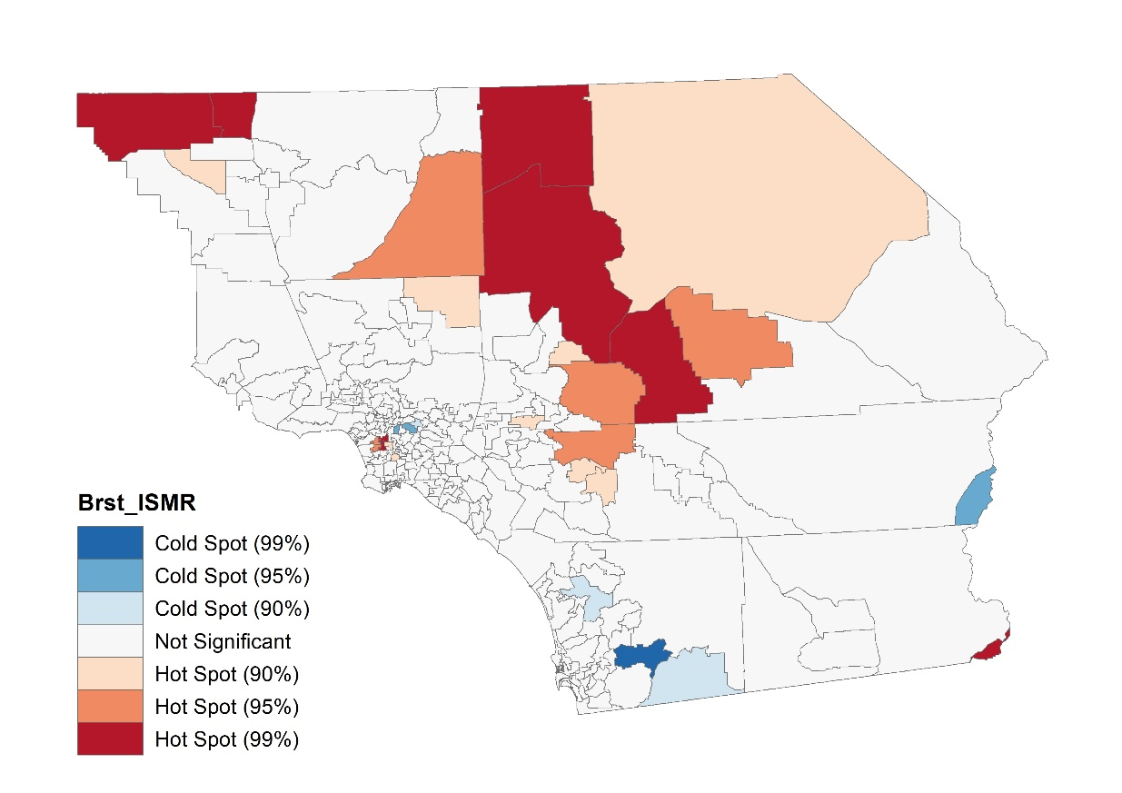
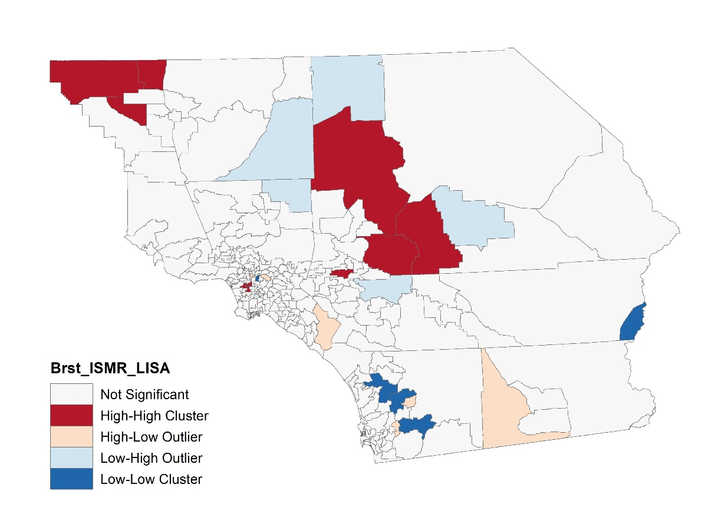
Spatial distribution of cancer
Breast Cancer: ISMR

Slide 4
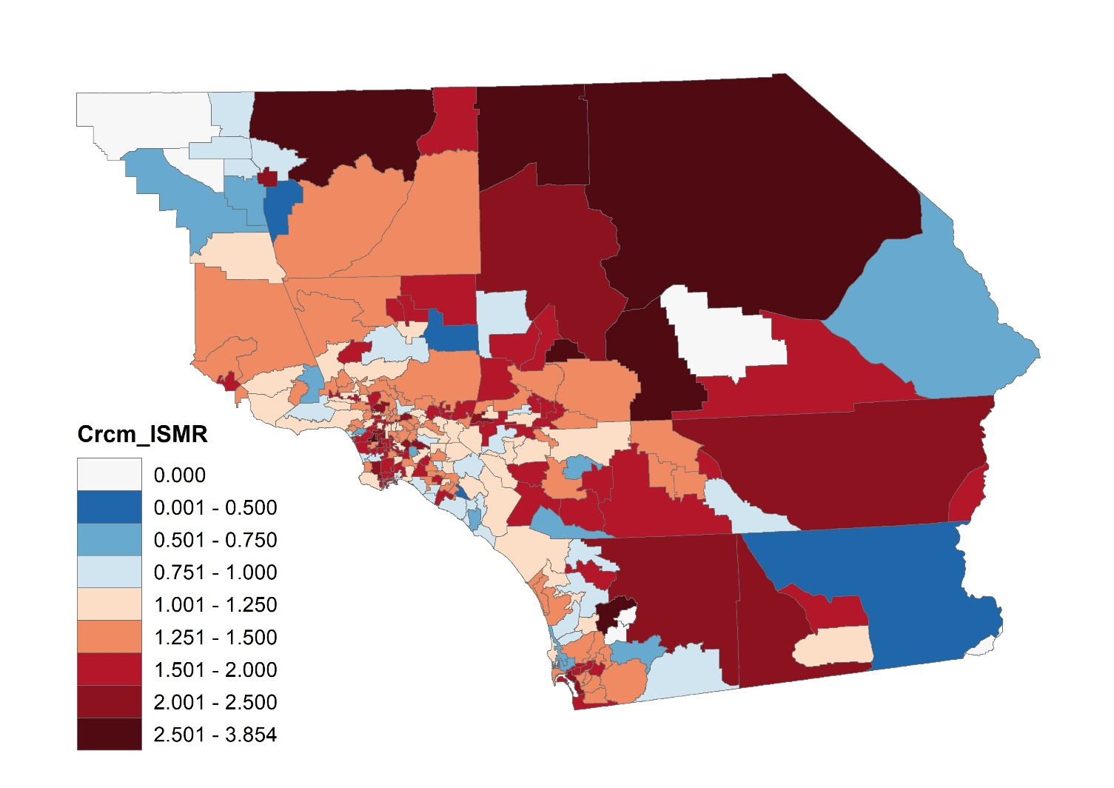
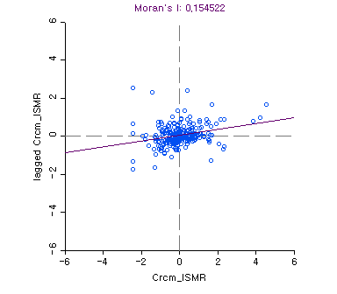
I. Spatial Distribution of Cancer
Colorectal Cancer (Male): ISMR

Slide 5
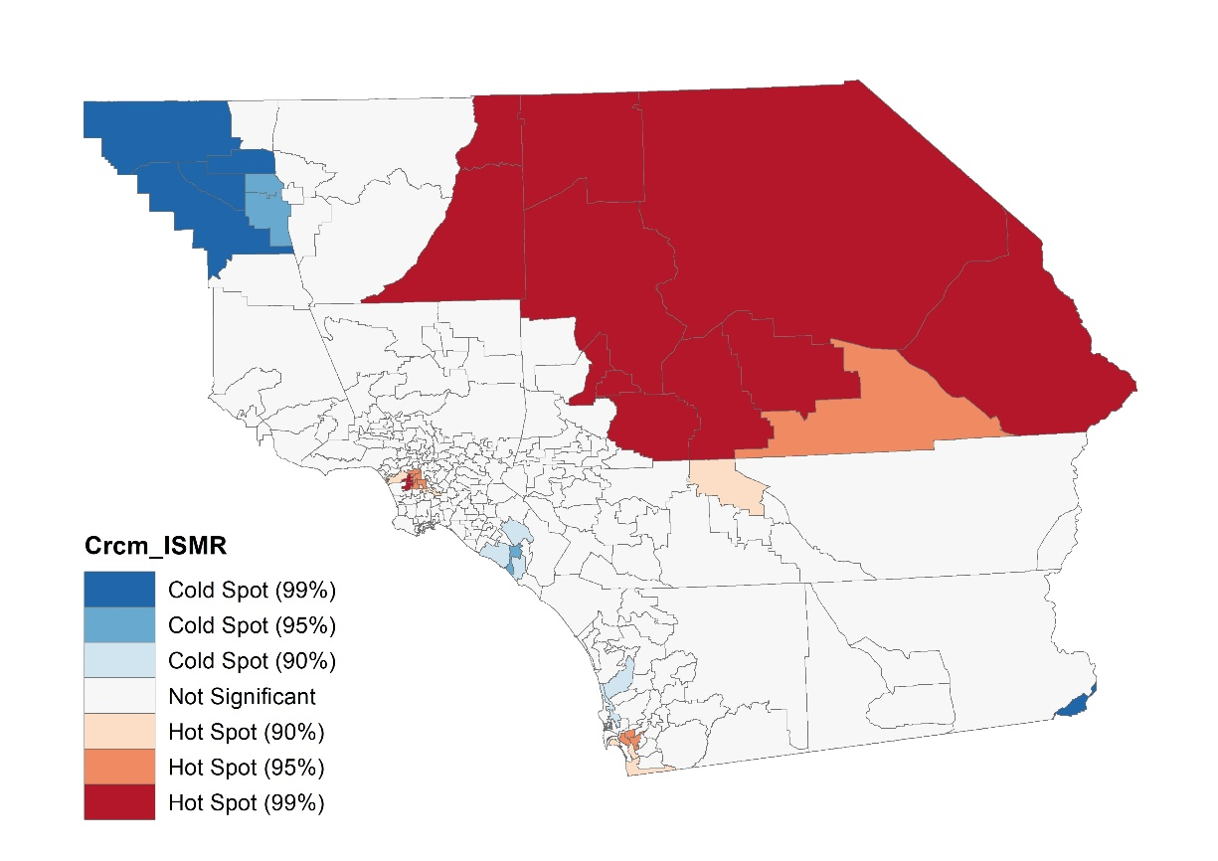
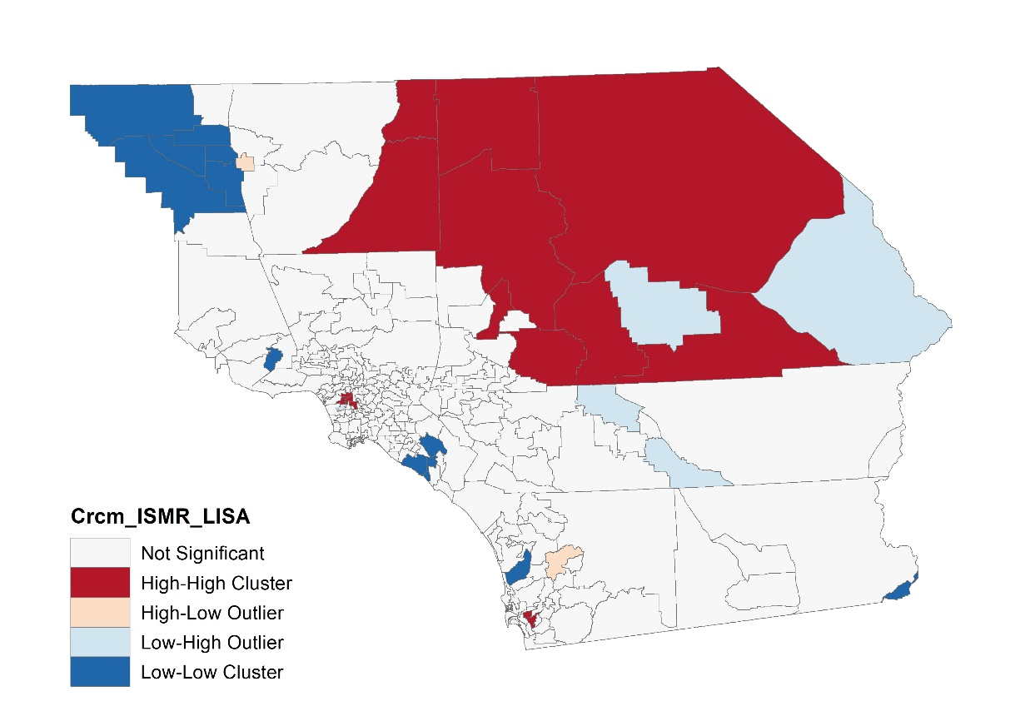
I. Spatial Distribution of Cancer
Colorectal Cancer (Male): ISMR

Slide 6
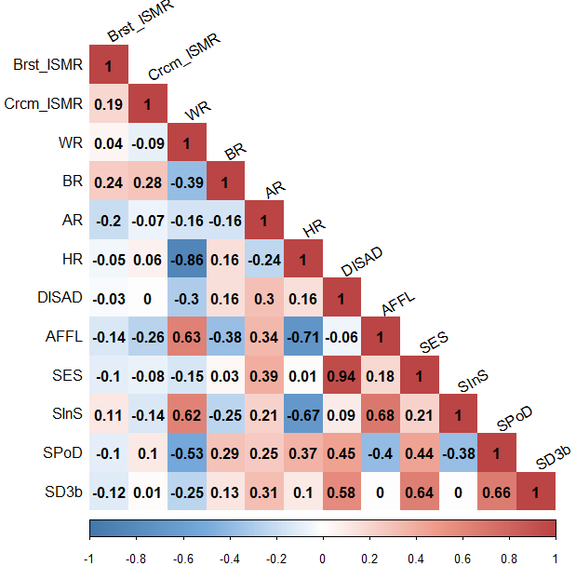
Correlation
Variables
2 dependent variables: ISMR (Breast, Colorectal-male)
4 racial variables: portion of races
4 social variables
2 neighborhood

Slide 7
1. Breast Cancer
Explanatory variables
BR: the proportion of black population (T0913_BLACK / T0913_TOTPOP)
HR: the proportion of Hispanic population (T0913_HISP / T0913_TOTPOP)
AFFL: affluence score (PCA score)
SInS: standardized the proportion of health-insured population (1sd: 0.089%p)
1 unit increase → increase 0.089%p of health-insured population
SPoD: standardized population density (1sd: 4,972.07 people / sq.mi)
1 unit increase → increase around 5 thousand people per square mile.

Slide 8
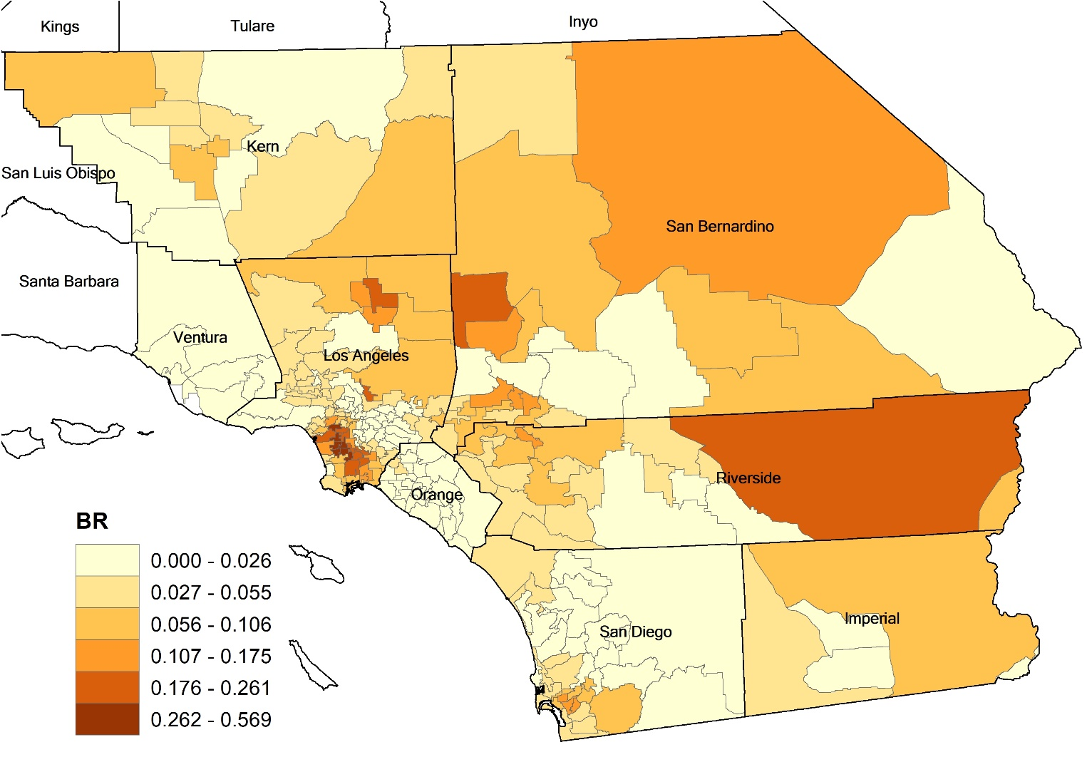
1. Breast Cancer
Explanatory variables
BR: the proportion of black population (T0913_BLACK / T0913_TOTPOP)

Slide 9
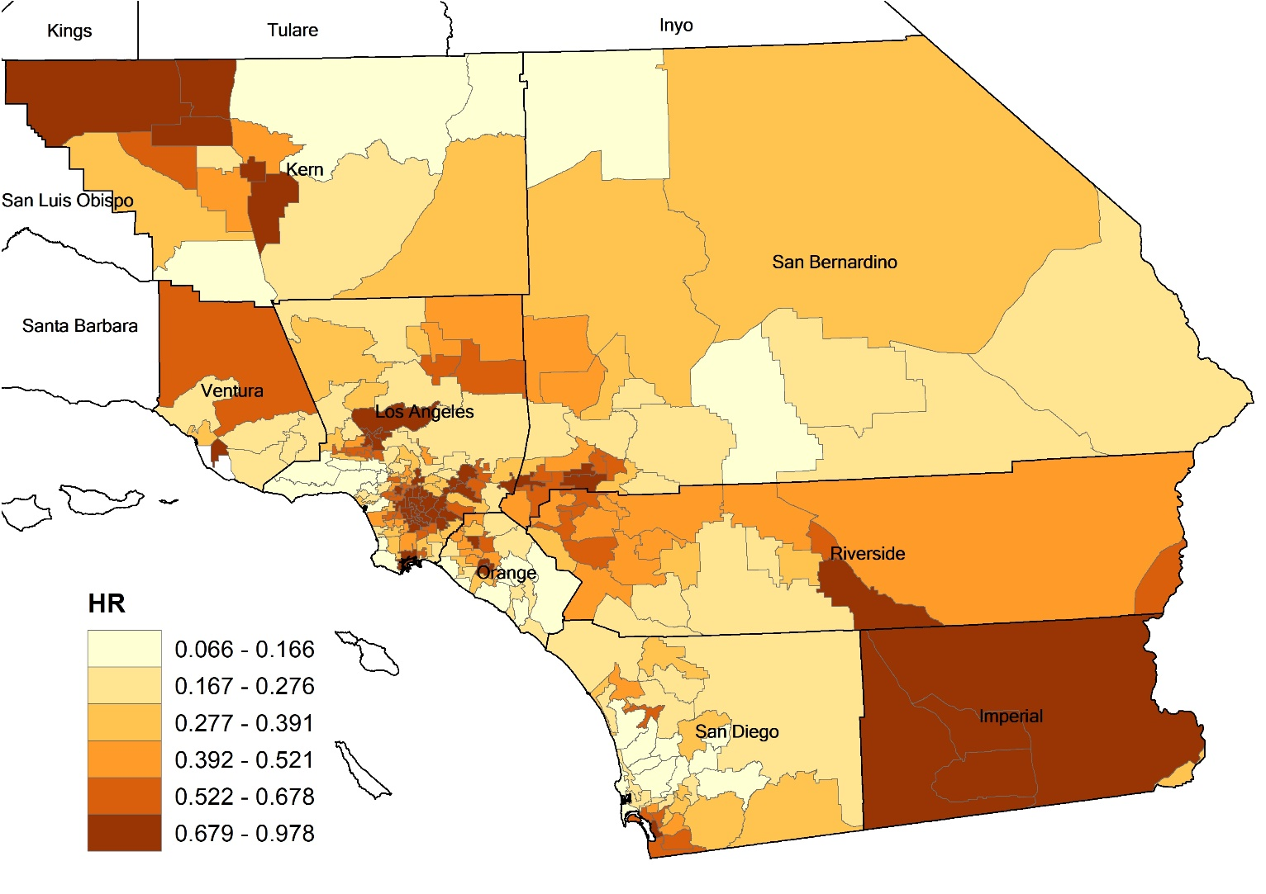
1. Breast Cancer
Explanatory variables
HR: the proportion of Hispanic population (T0913_HISP / T0913_TOTPOP)

Slide 10
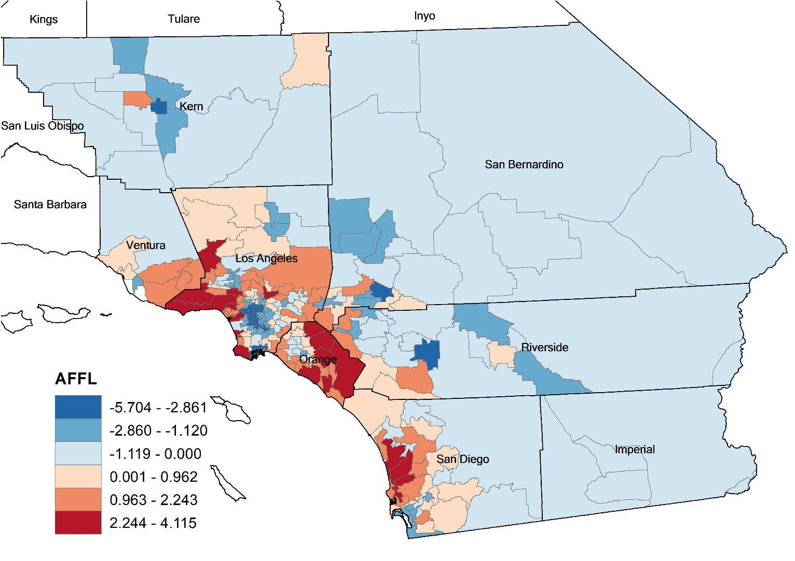
1. Breast Cancer
Explanatory variables
AFFL: affluence score (PCA score)

Slide 11
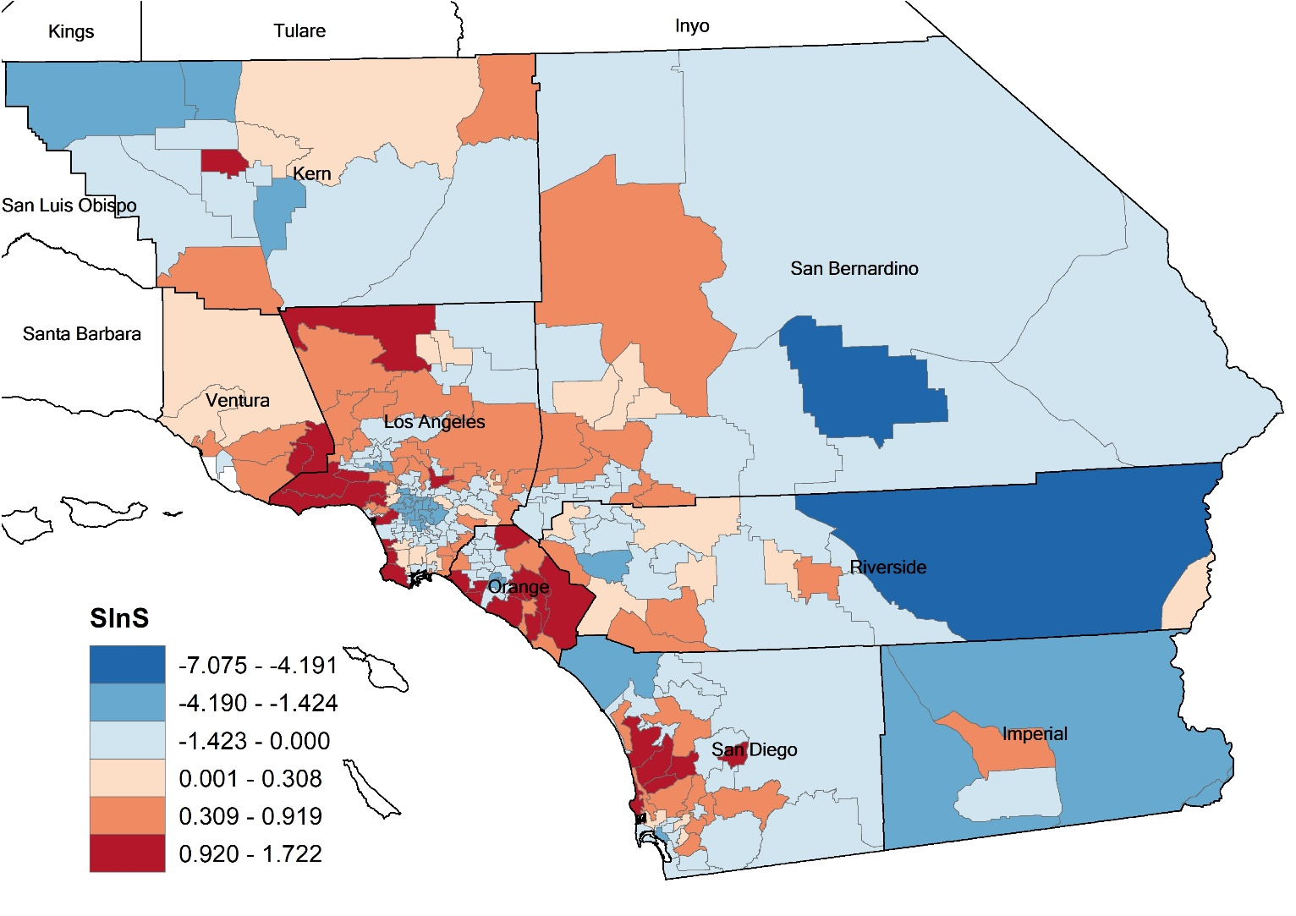
1. Breast Cancer
Explanatory variables
SInS: standardized the proportion of health-insured population (1sd: 0.089%p)
1 unit increase → increase 0.089%p of health-insured population

Slide 12
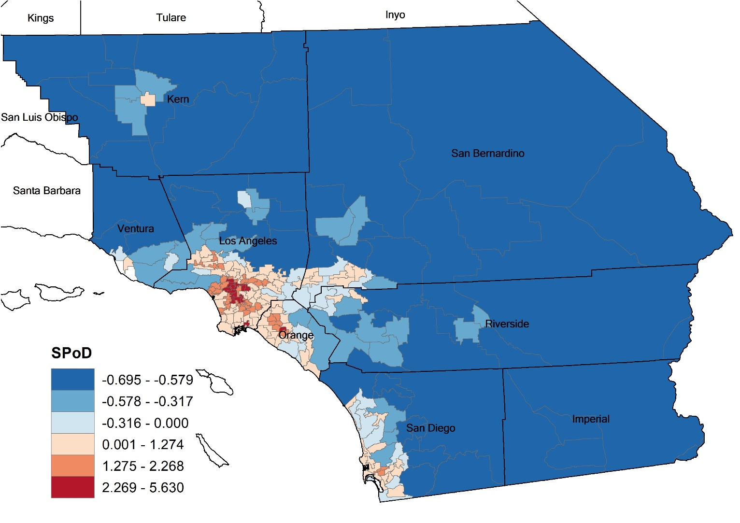
1. Breast Cancer
Explanatory variables
SPoD: standardized population density (1sd: 4,972.07 people / sq.mi)
1 unit increase → increase around 5 thousand people per square mile.

Slide 13
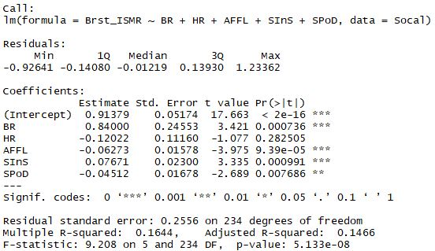
1. Breast Cancer
Global Model: ISMR
AIC:

Slide 14
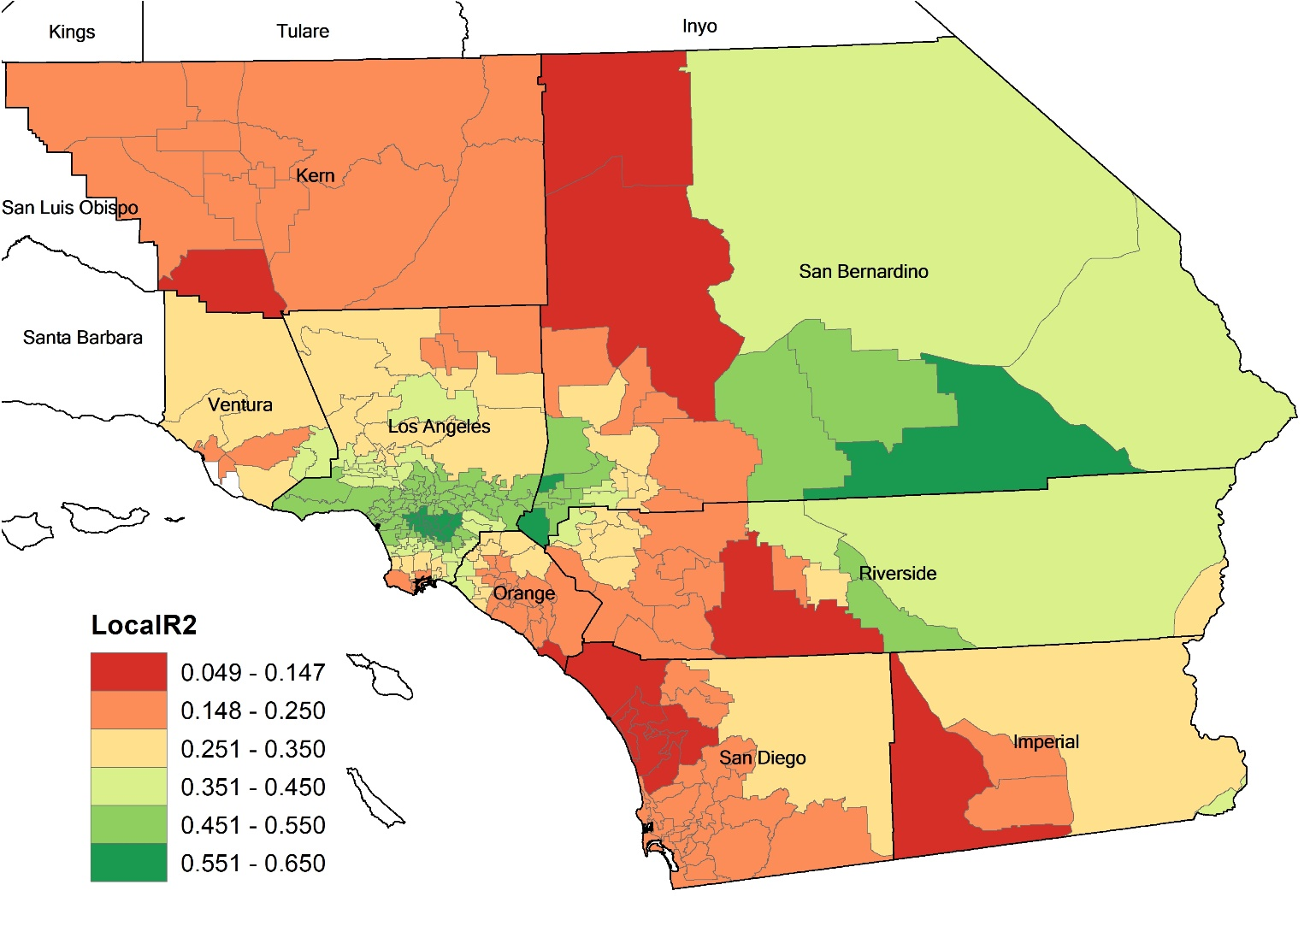
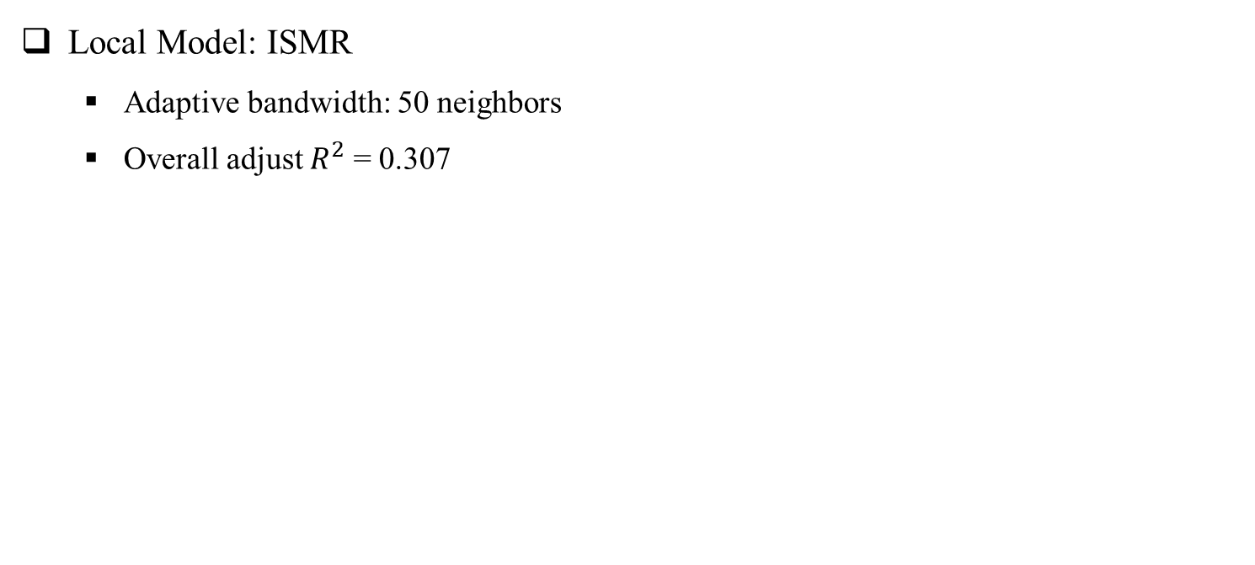
1. Breast Cancer
Local Model: ISMR
Adaptive bandwidth: 50 neighbors
Overall adjust $R^{2}$ = 0.307

Slide 15
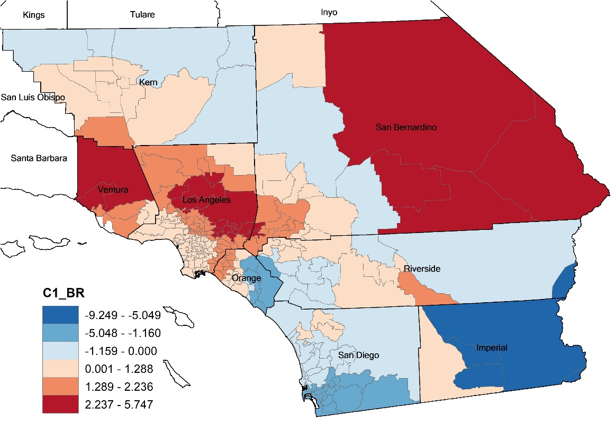
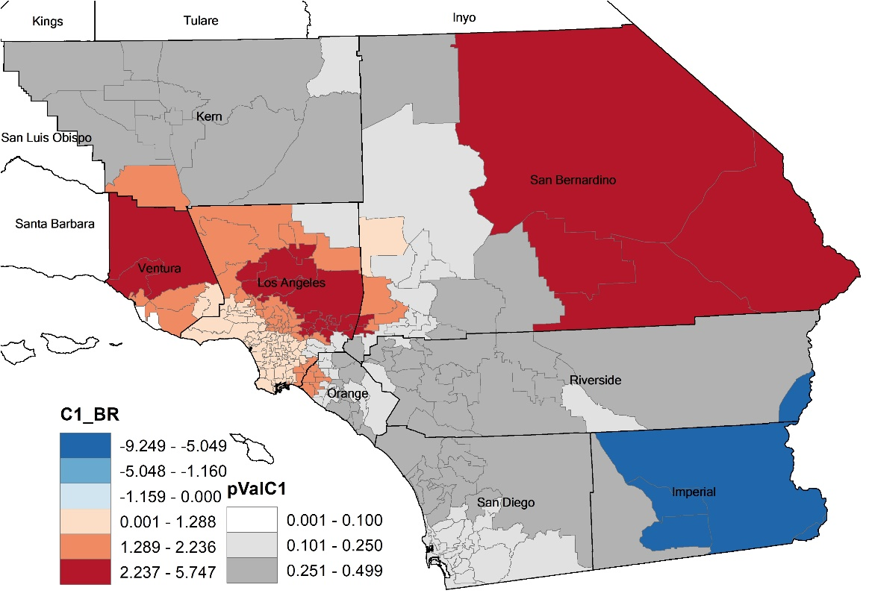
1. Breast cancer
Local Model: ISMR
Coefficients
BR
SHR
AFFL
SInS
SPoD

Slide 16
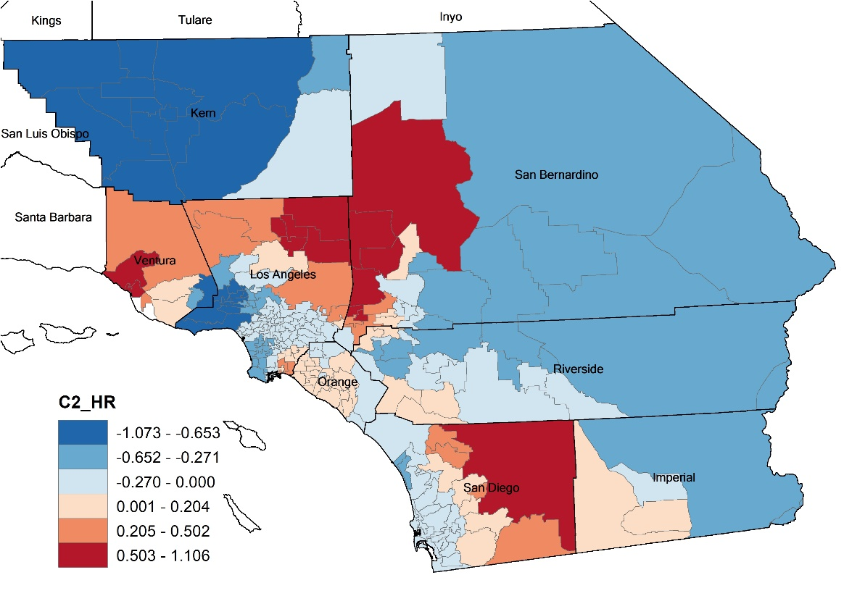
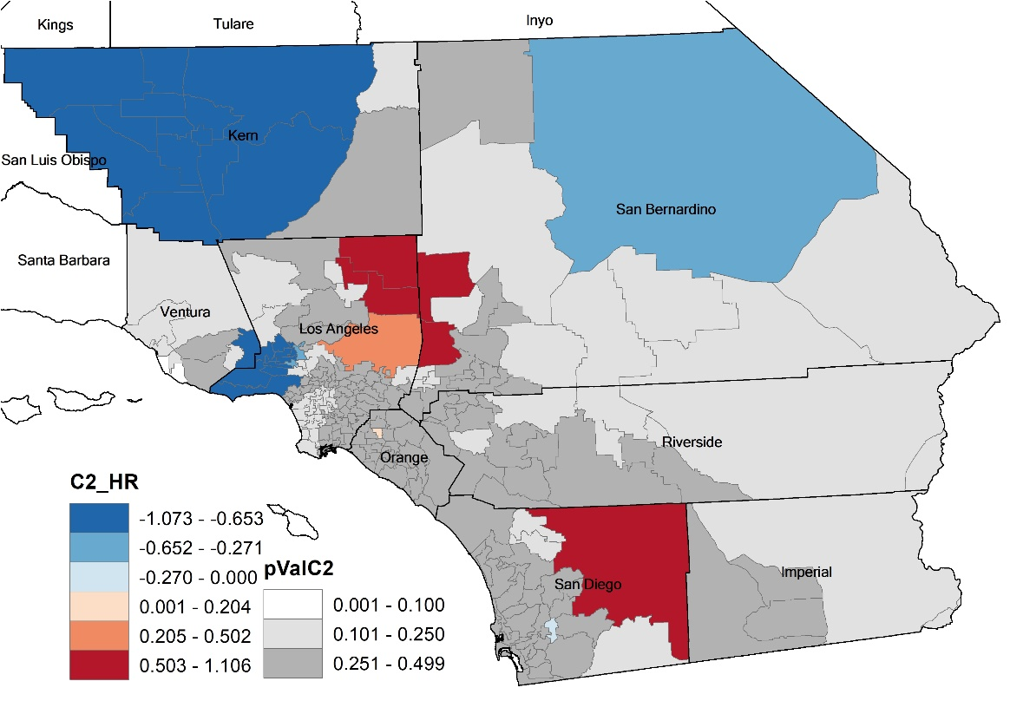
1. Breast cancer
Local Model: ISMR
Coefficients
BR
HR
AFFL
SInS
SPoD

Slide 17
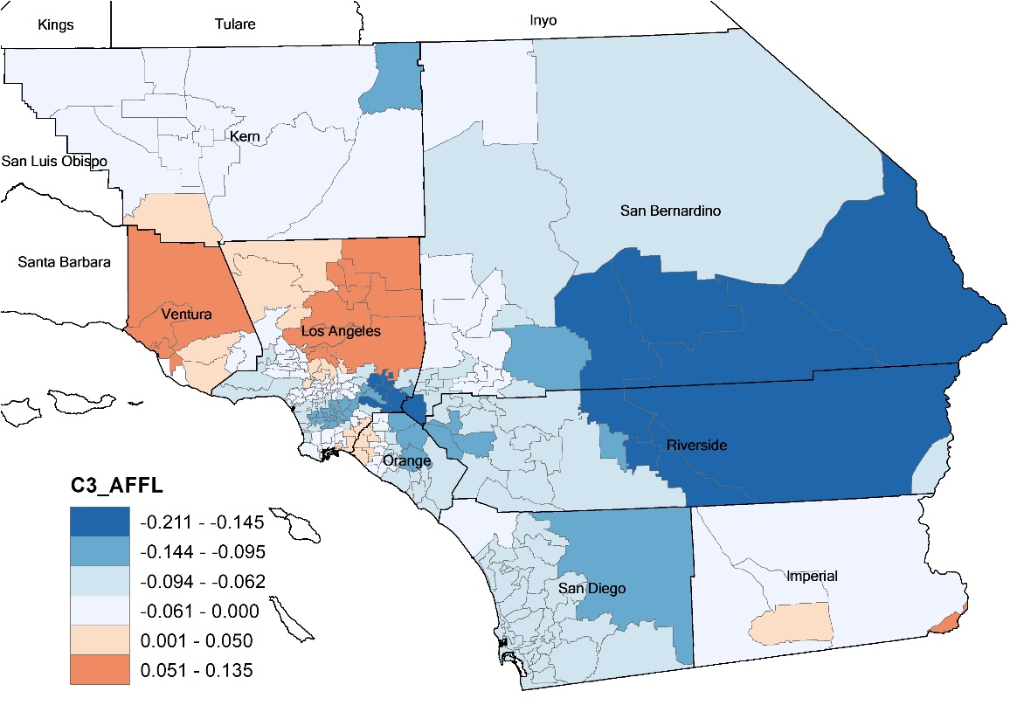
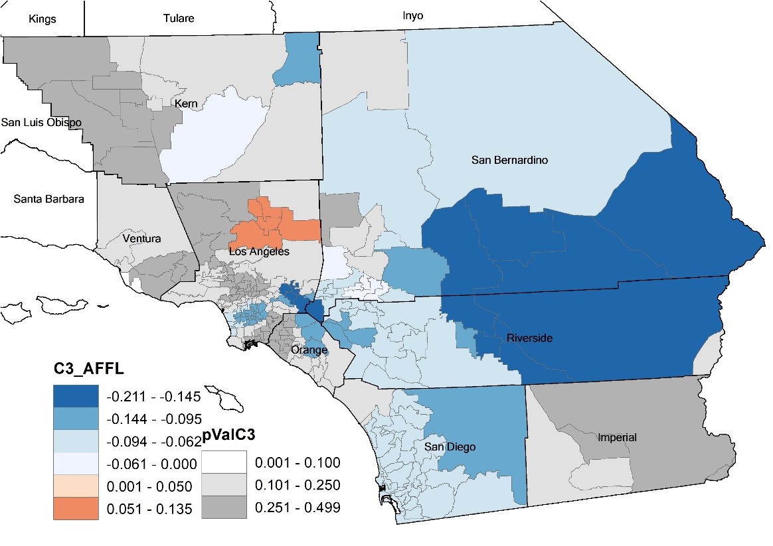
1. Breast cancer
Local Model: ISMR
Coefficients
BR
HR
AFFL
SInS
SPoD

Slide 18
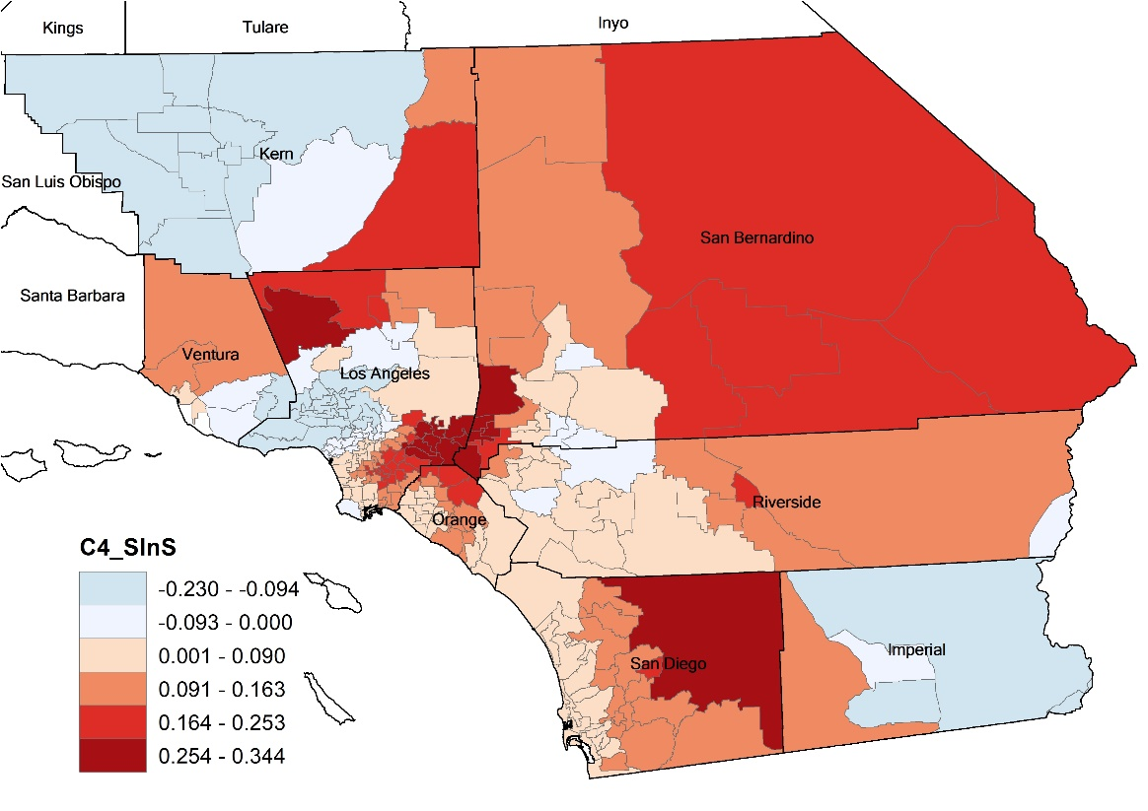
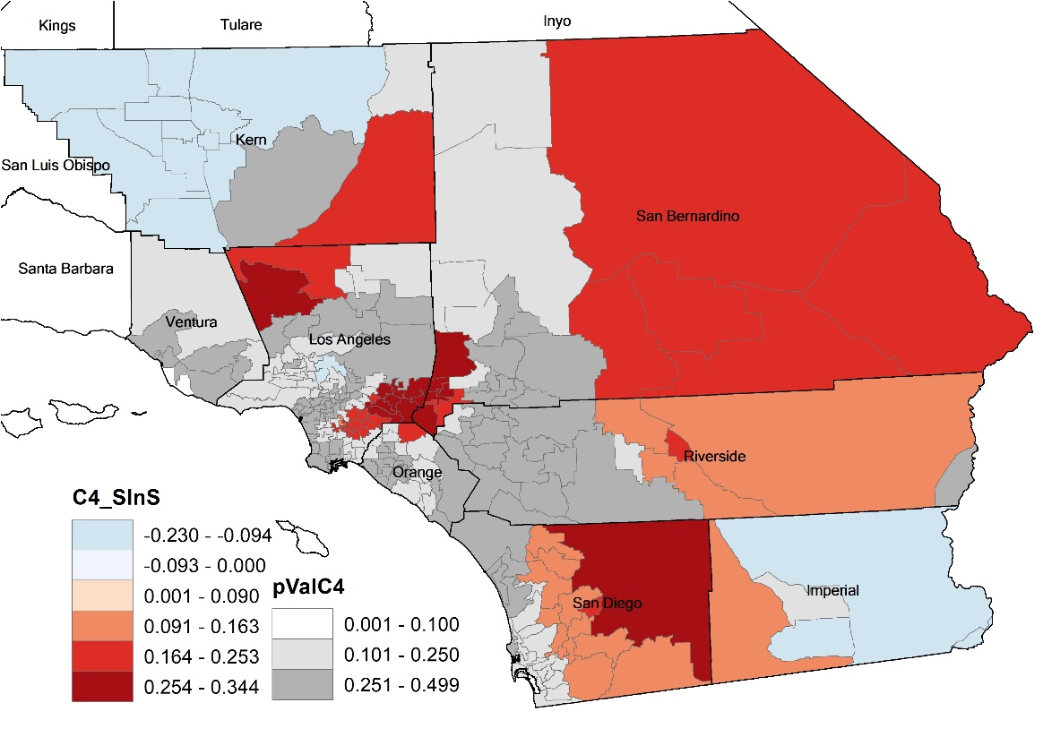
1. Breast cancer
Local Model: ISMR
Coefficients
BR
HR
AFFL
SInS
SPoD

Slide 19
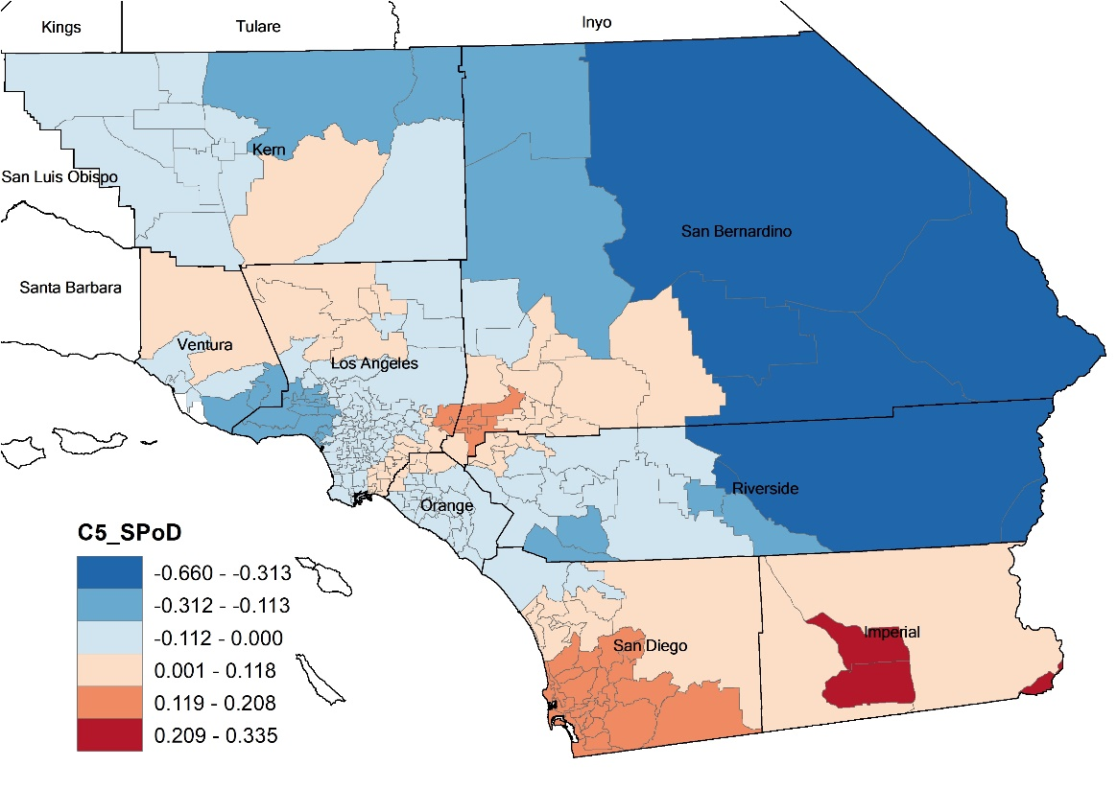
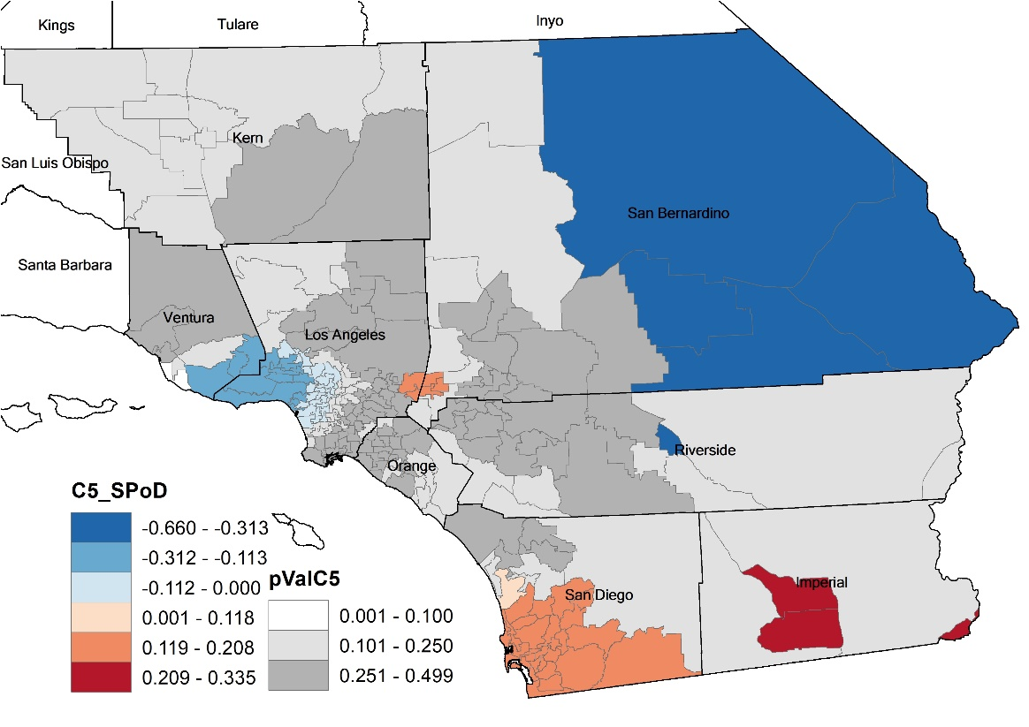
1. Breast cancer
Local Model: ISMR
Coefficients
BR
HR
AFFL
SInS
SPoD

Slide 20
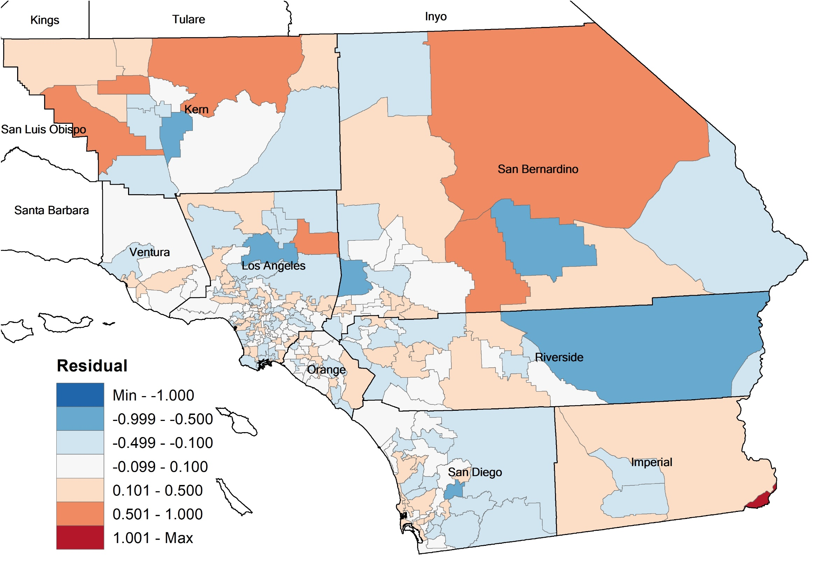
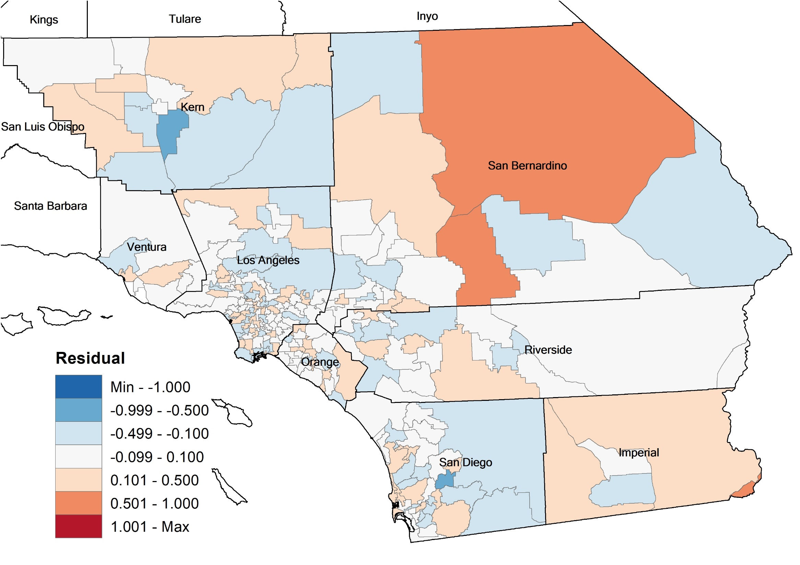
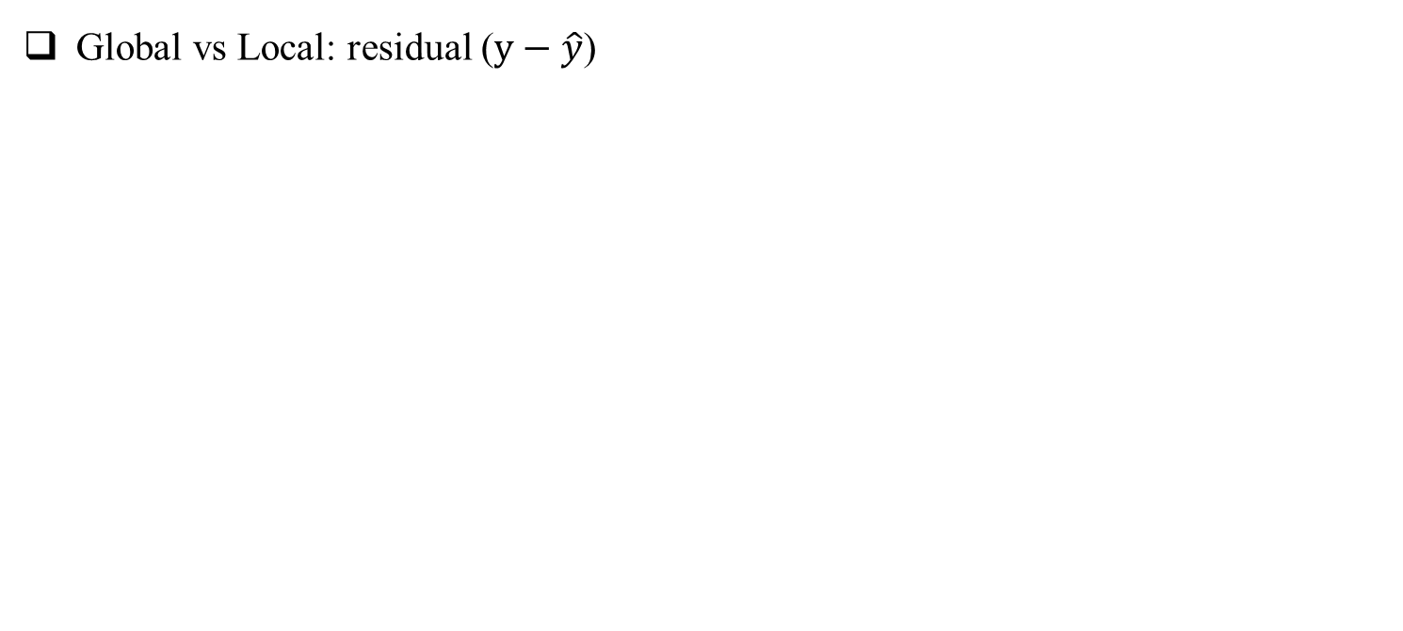
1. Breast cancer
Global vs Local: residual ($y−\hat{y}$)
OLS
GWR
OLS | Breast cancer | GWR
0.186 | Mean absolute error (MAE) | 0.141
0.252 | Root mean square error (RMSE) | 0.189

Slide 21
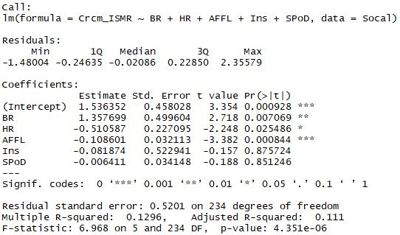
2. Colorectal Cancer (Male)
Global Model: ISMR

Slide 22
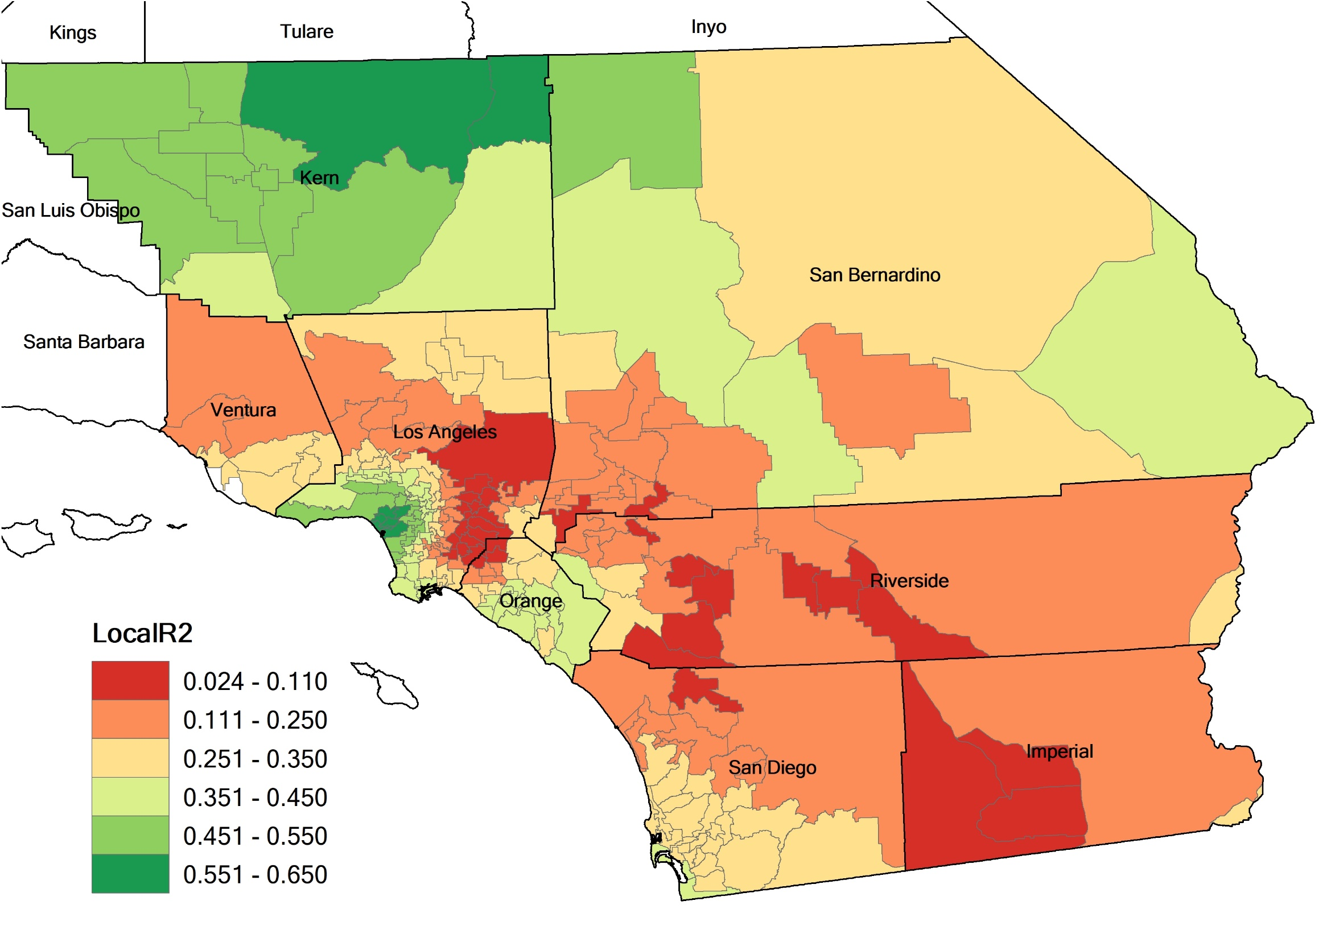
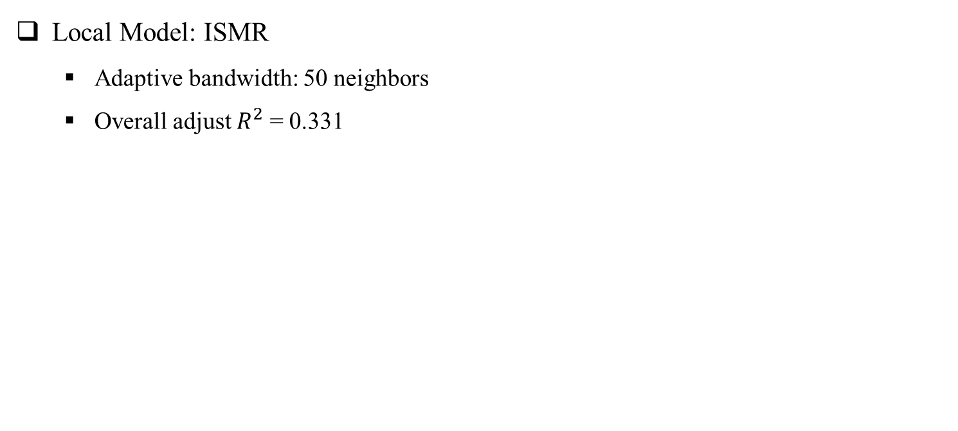
2. Colorectal Cancer (Male)
Local Model: ISMR
Adaptive bandwidth: 50 neighbors
Overall adjust $R^{2}$ = 0.331

Slide 23
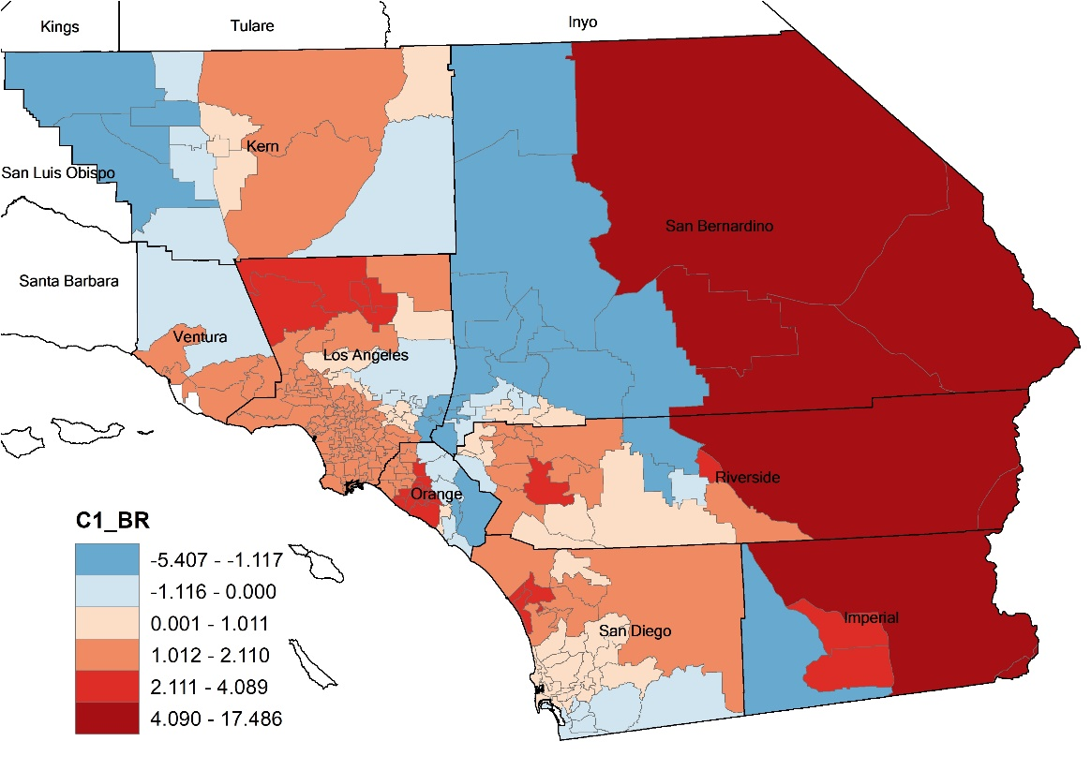
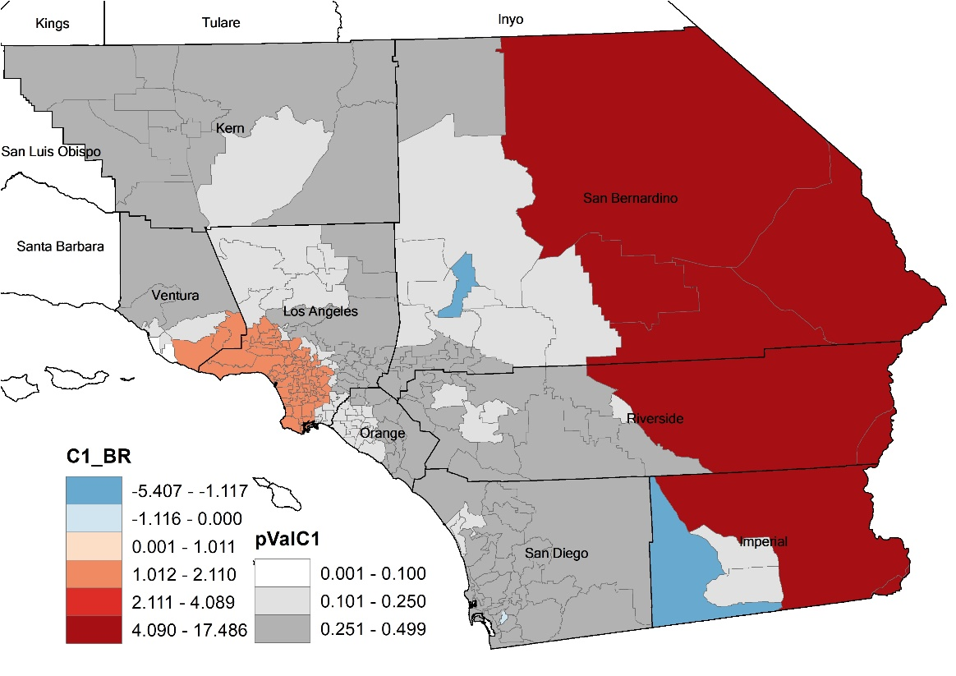
2. Colorectal Cancer (Male)
Local Model: ISMR
Coefficients
BR
SHR
AFFL
SInS
SPoD

Slide 24
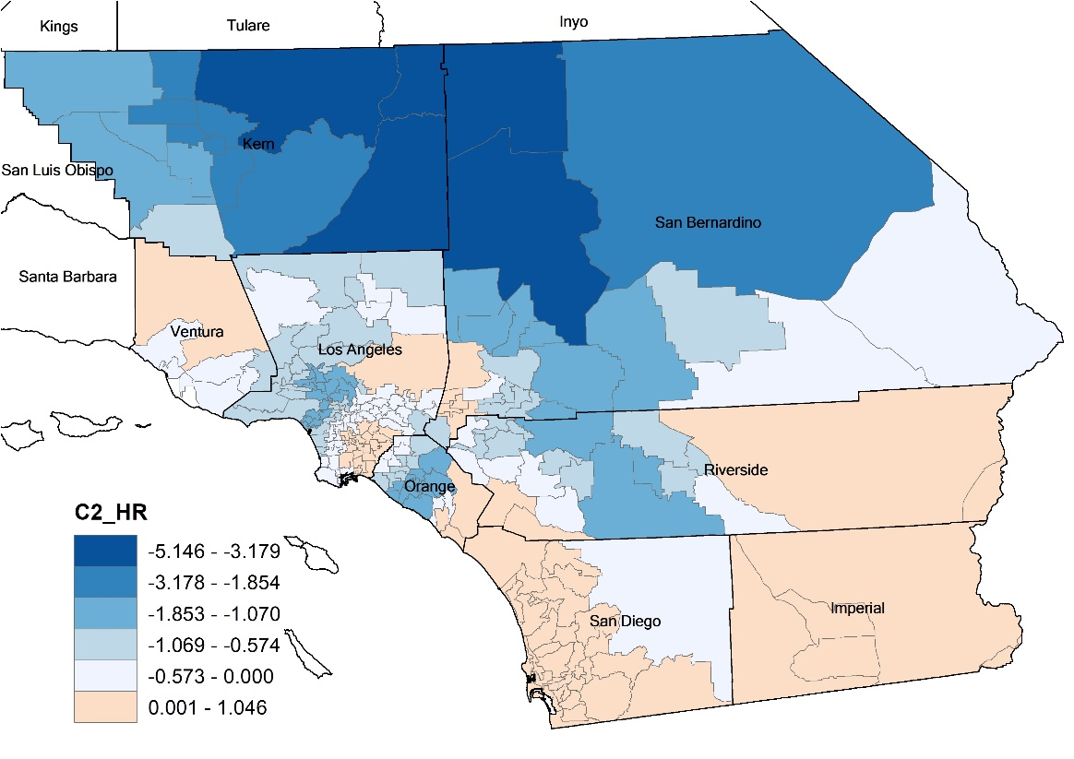
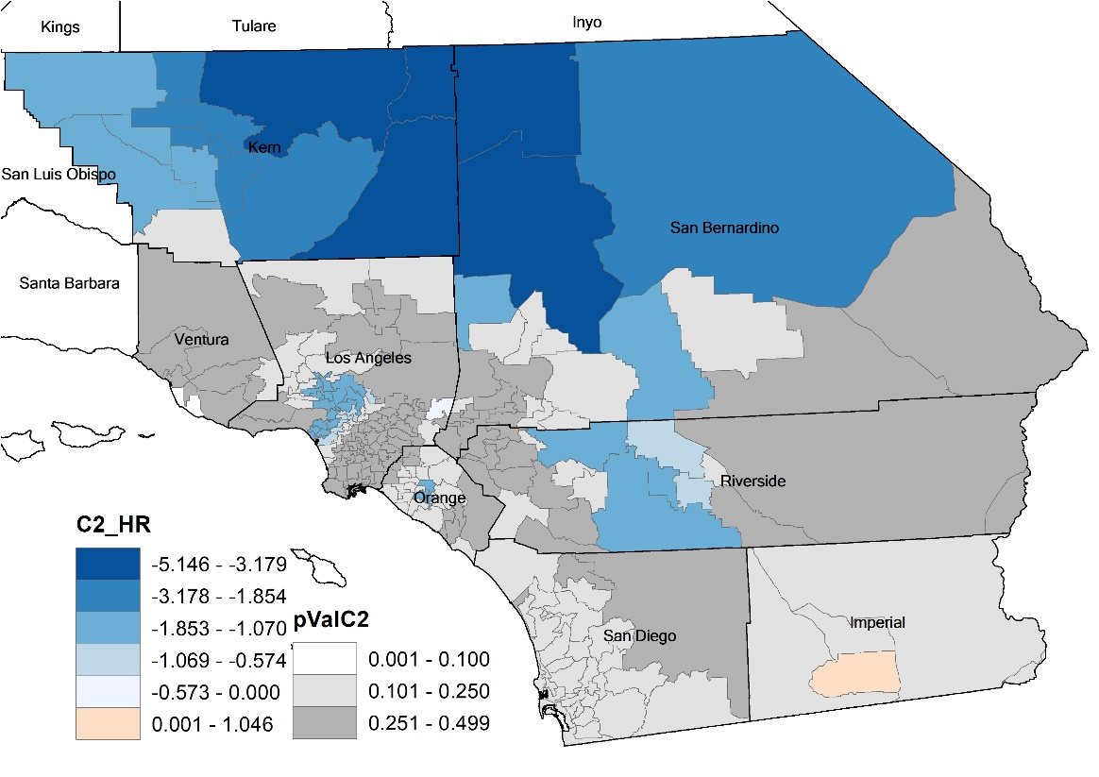
2. Colorectal Cancer (Male)
Local Model: ISMR
Coefficients
BR
HR
AFFL
SInS
SPoD

Slide 25
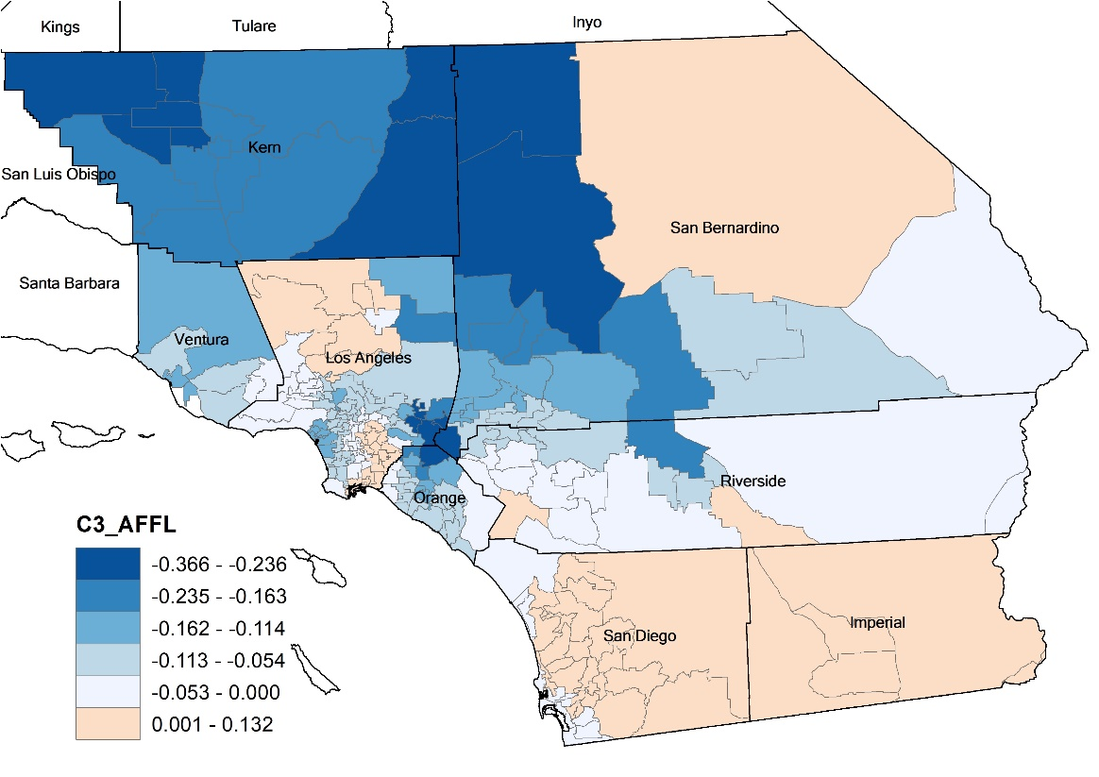
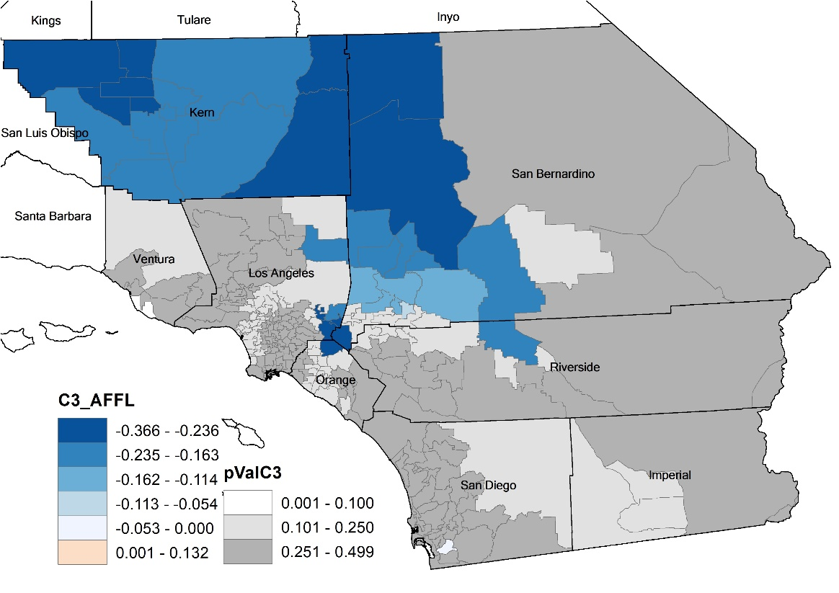
2. Colorectal Cancer (Male)
Local Model: ISMR
Coefficients
BR
HR
AFFL
SInS
SPoD

Slide 26
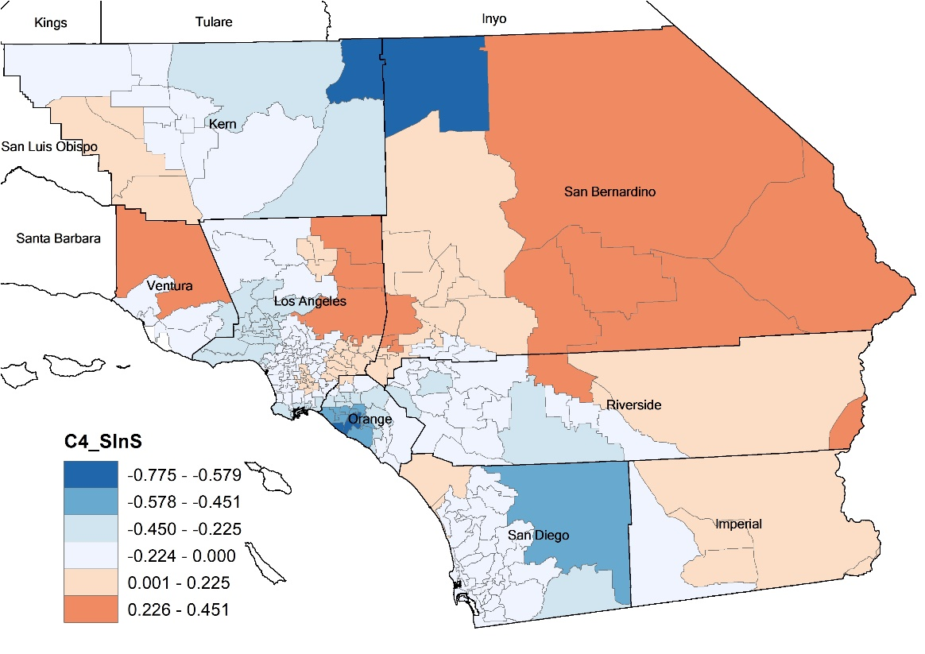
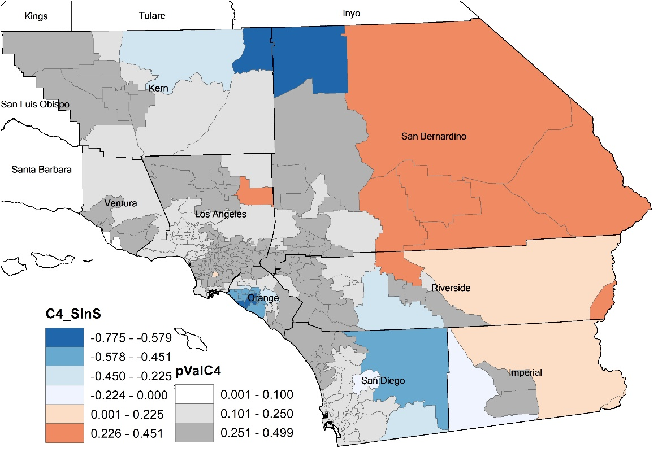
2. Colorectal Cancer (Male)
Local Model: ISMR
Coefficients
BR
HR
AFFL
SInS
SPoD

Slide 27
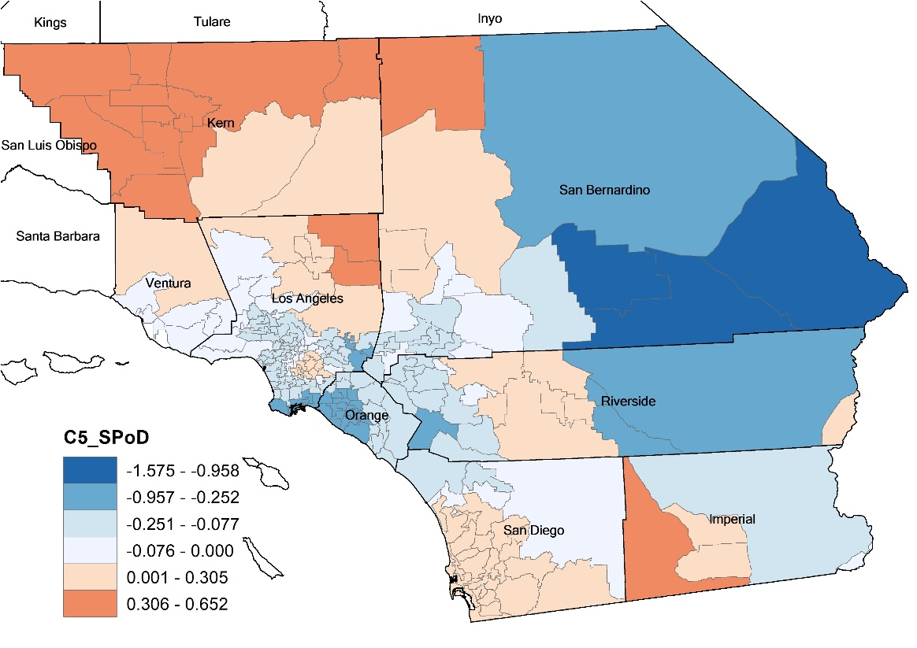
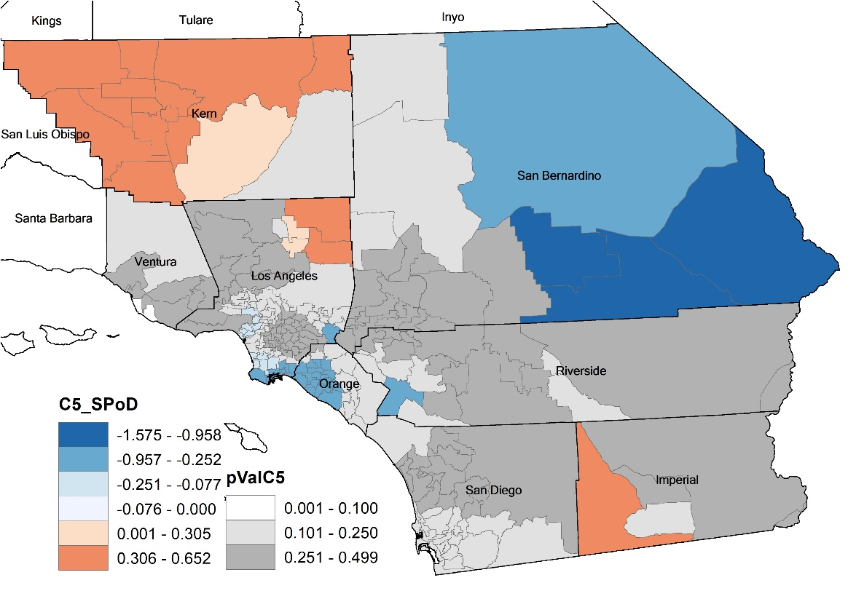
2. Colorectal Cancer (Male)
Local Model: ISMR
Coefficients
BR
HR
AFFL
SInS
SPoD

Slide 28
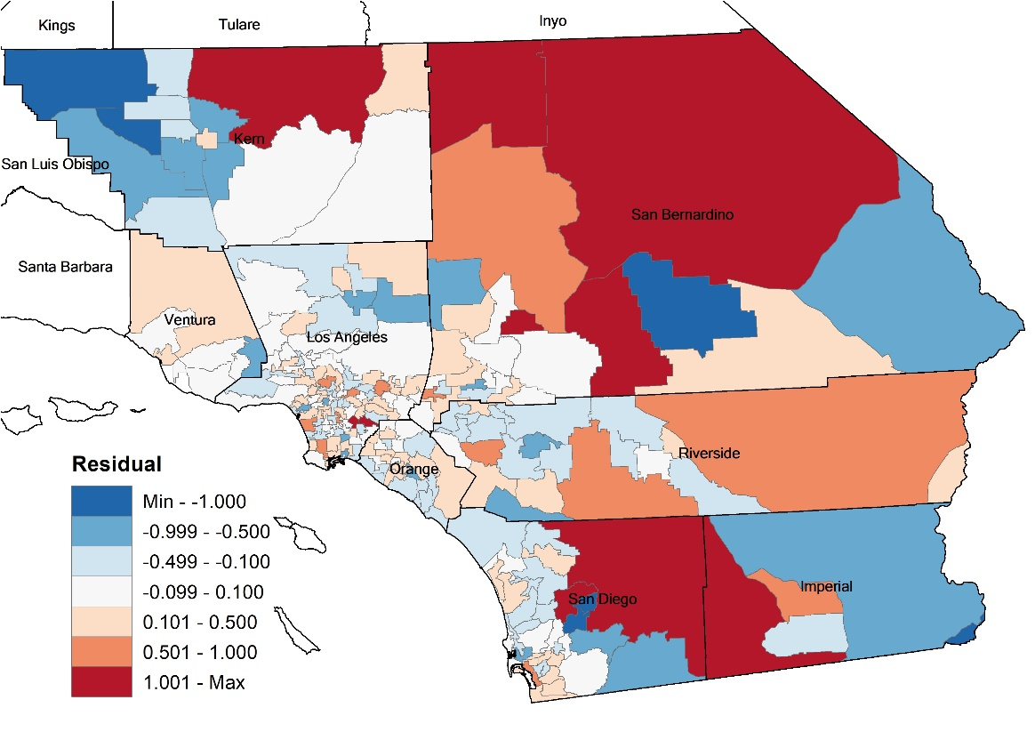
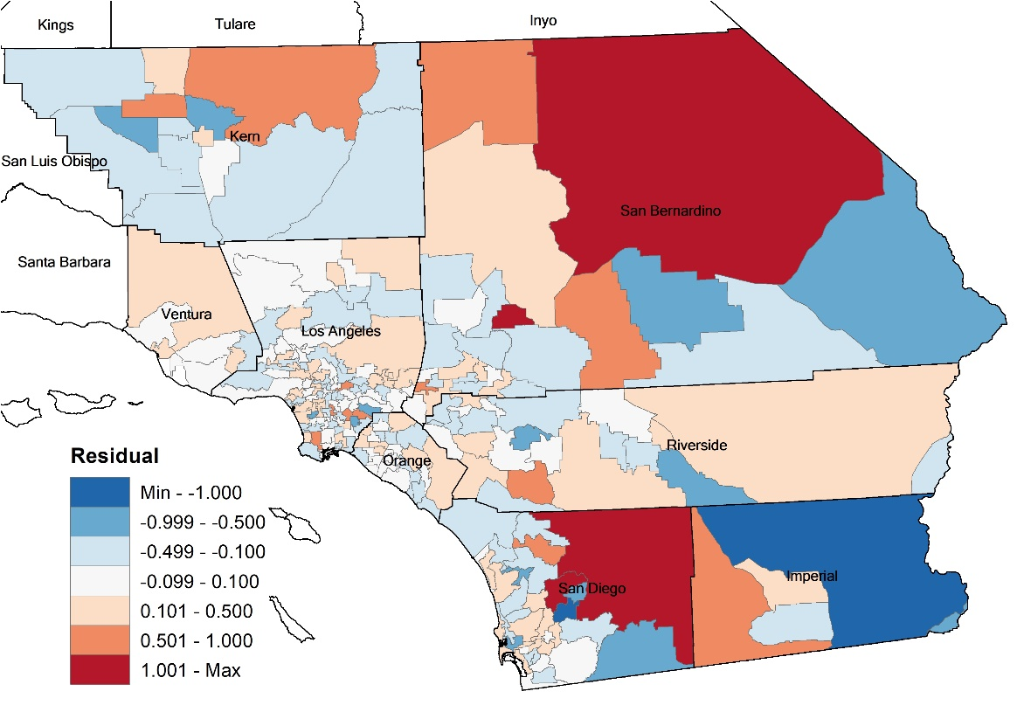
2. Colorectal Cancer (Male)
Global vs Local: residual ($y−\hat{y}$)
OLS
GWR
OLS | Colorectal cancer (male) | GWR
0.252 | Mean absolute error (MAE) | 0.189
0.514 | Root mean square error (RMSE) | 0.369

